Slide 1
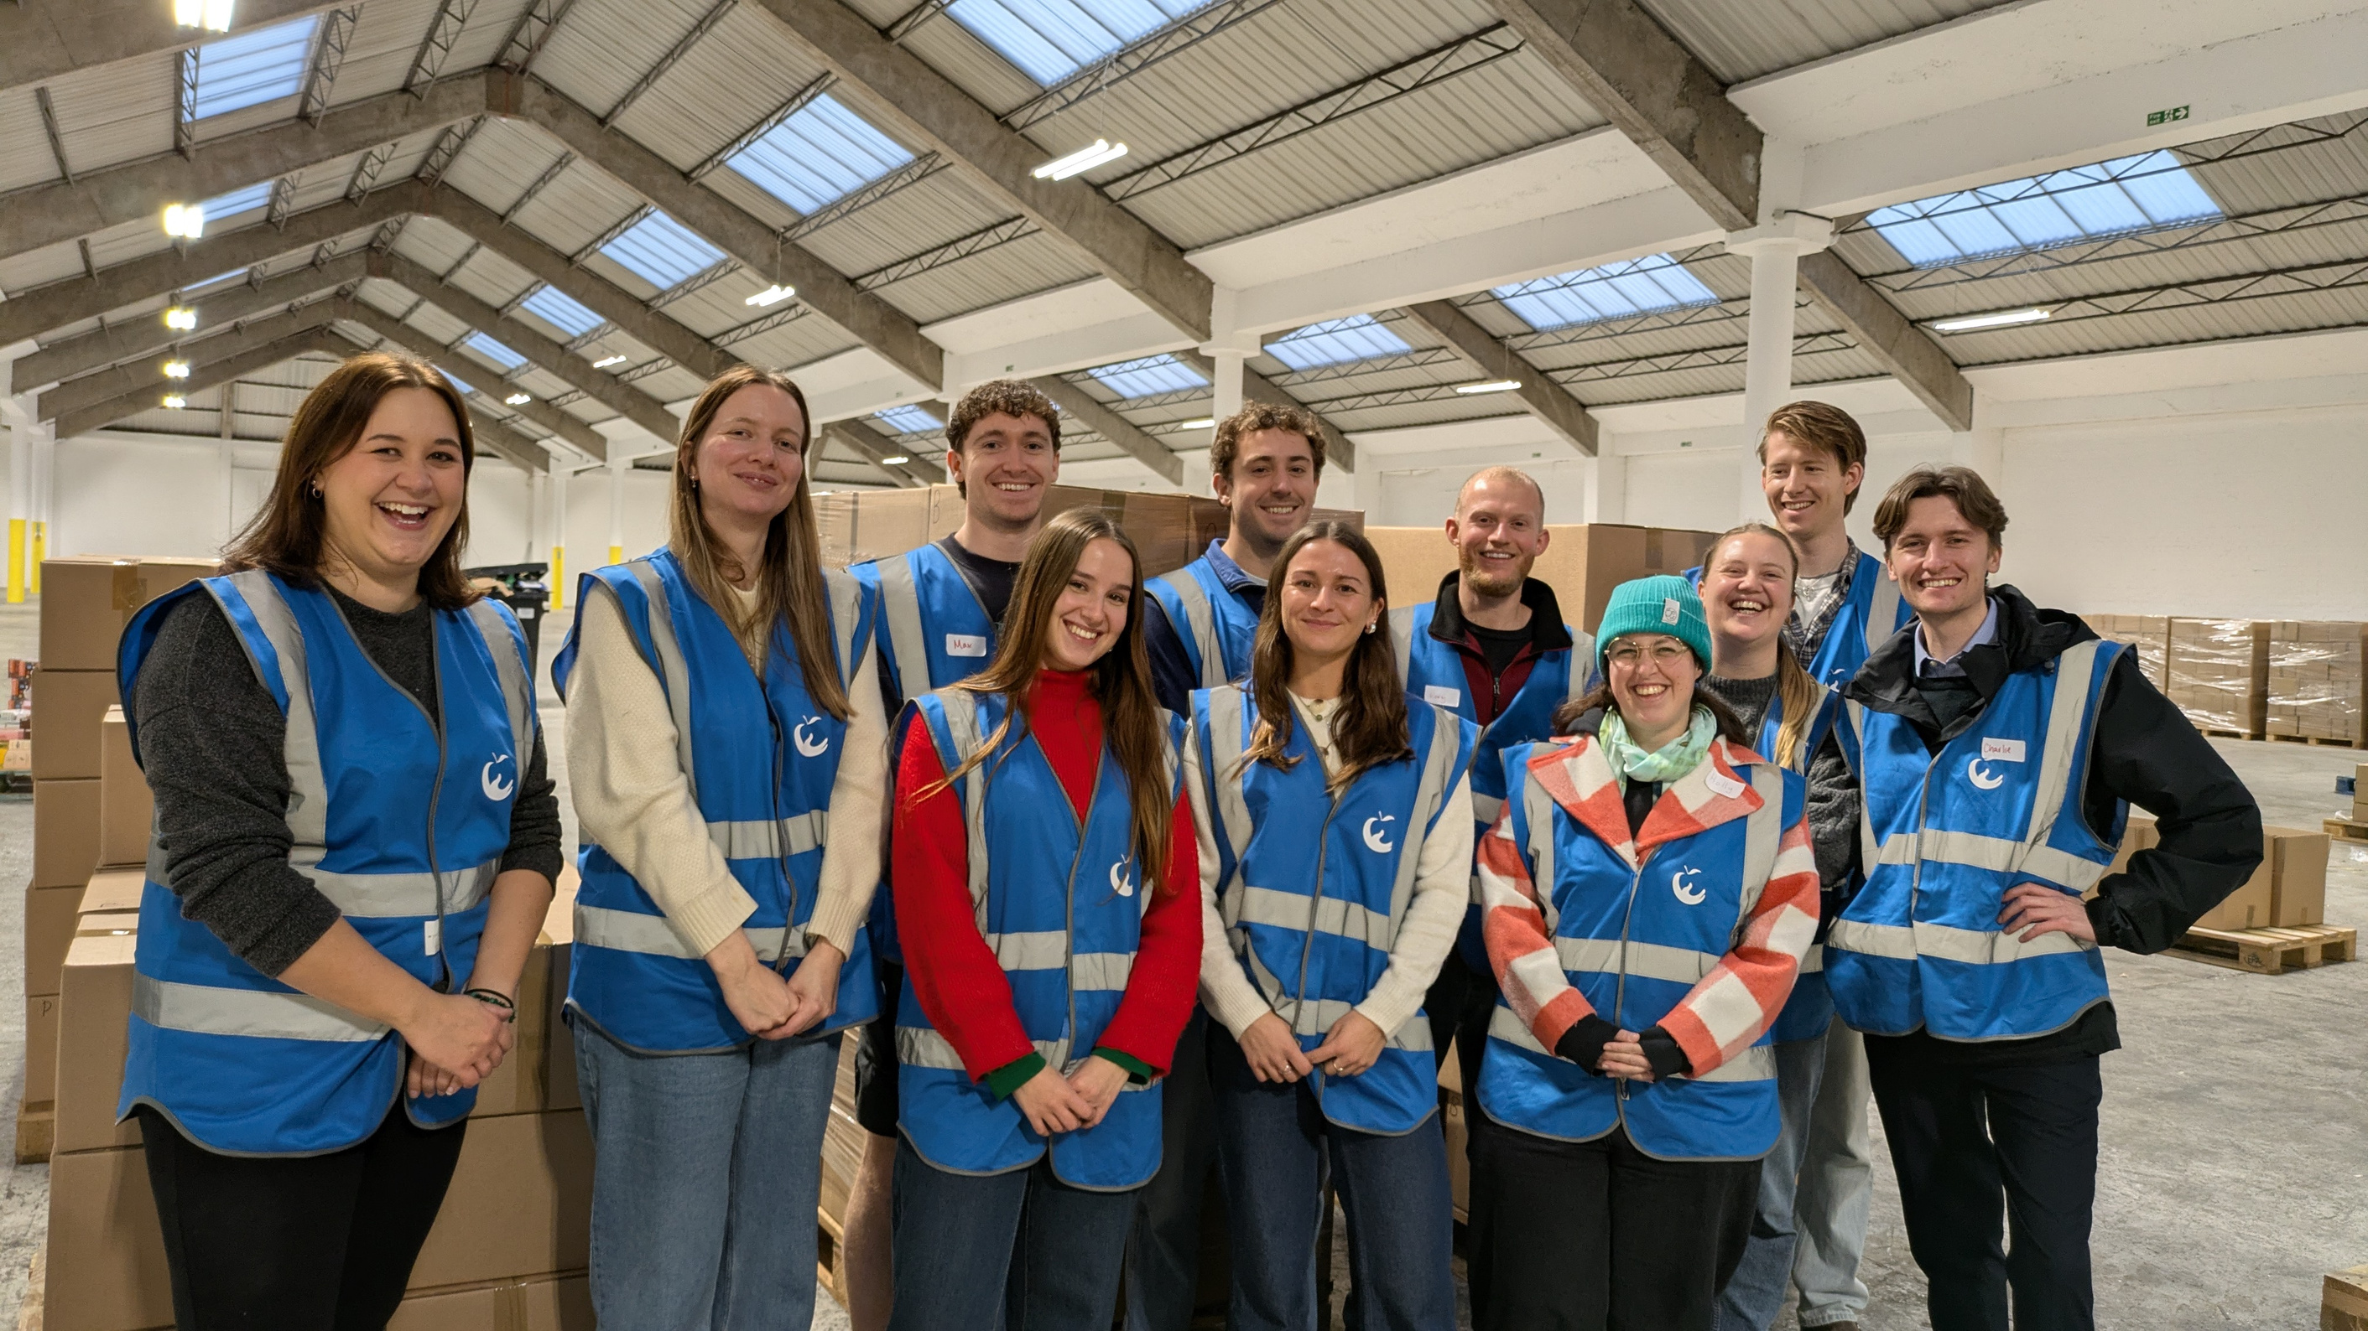
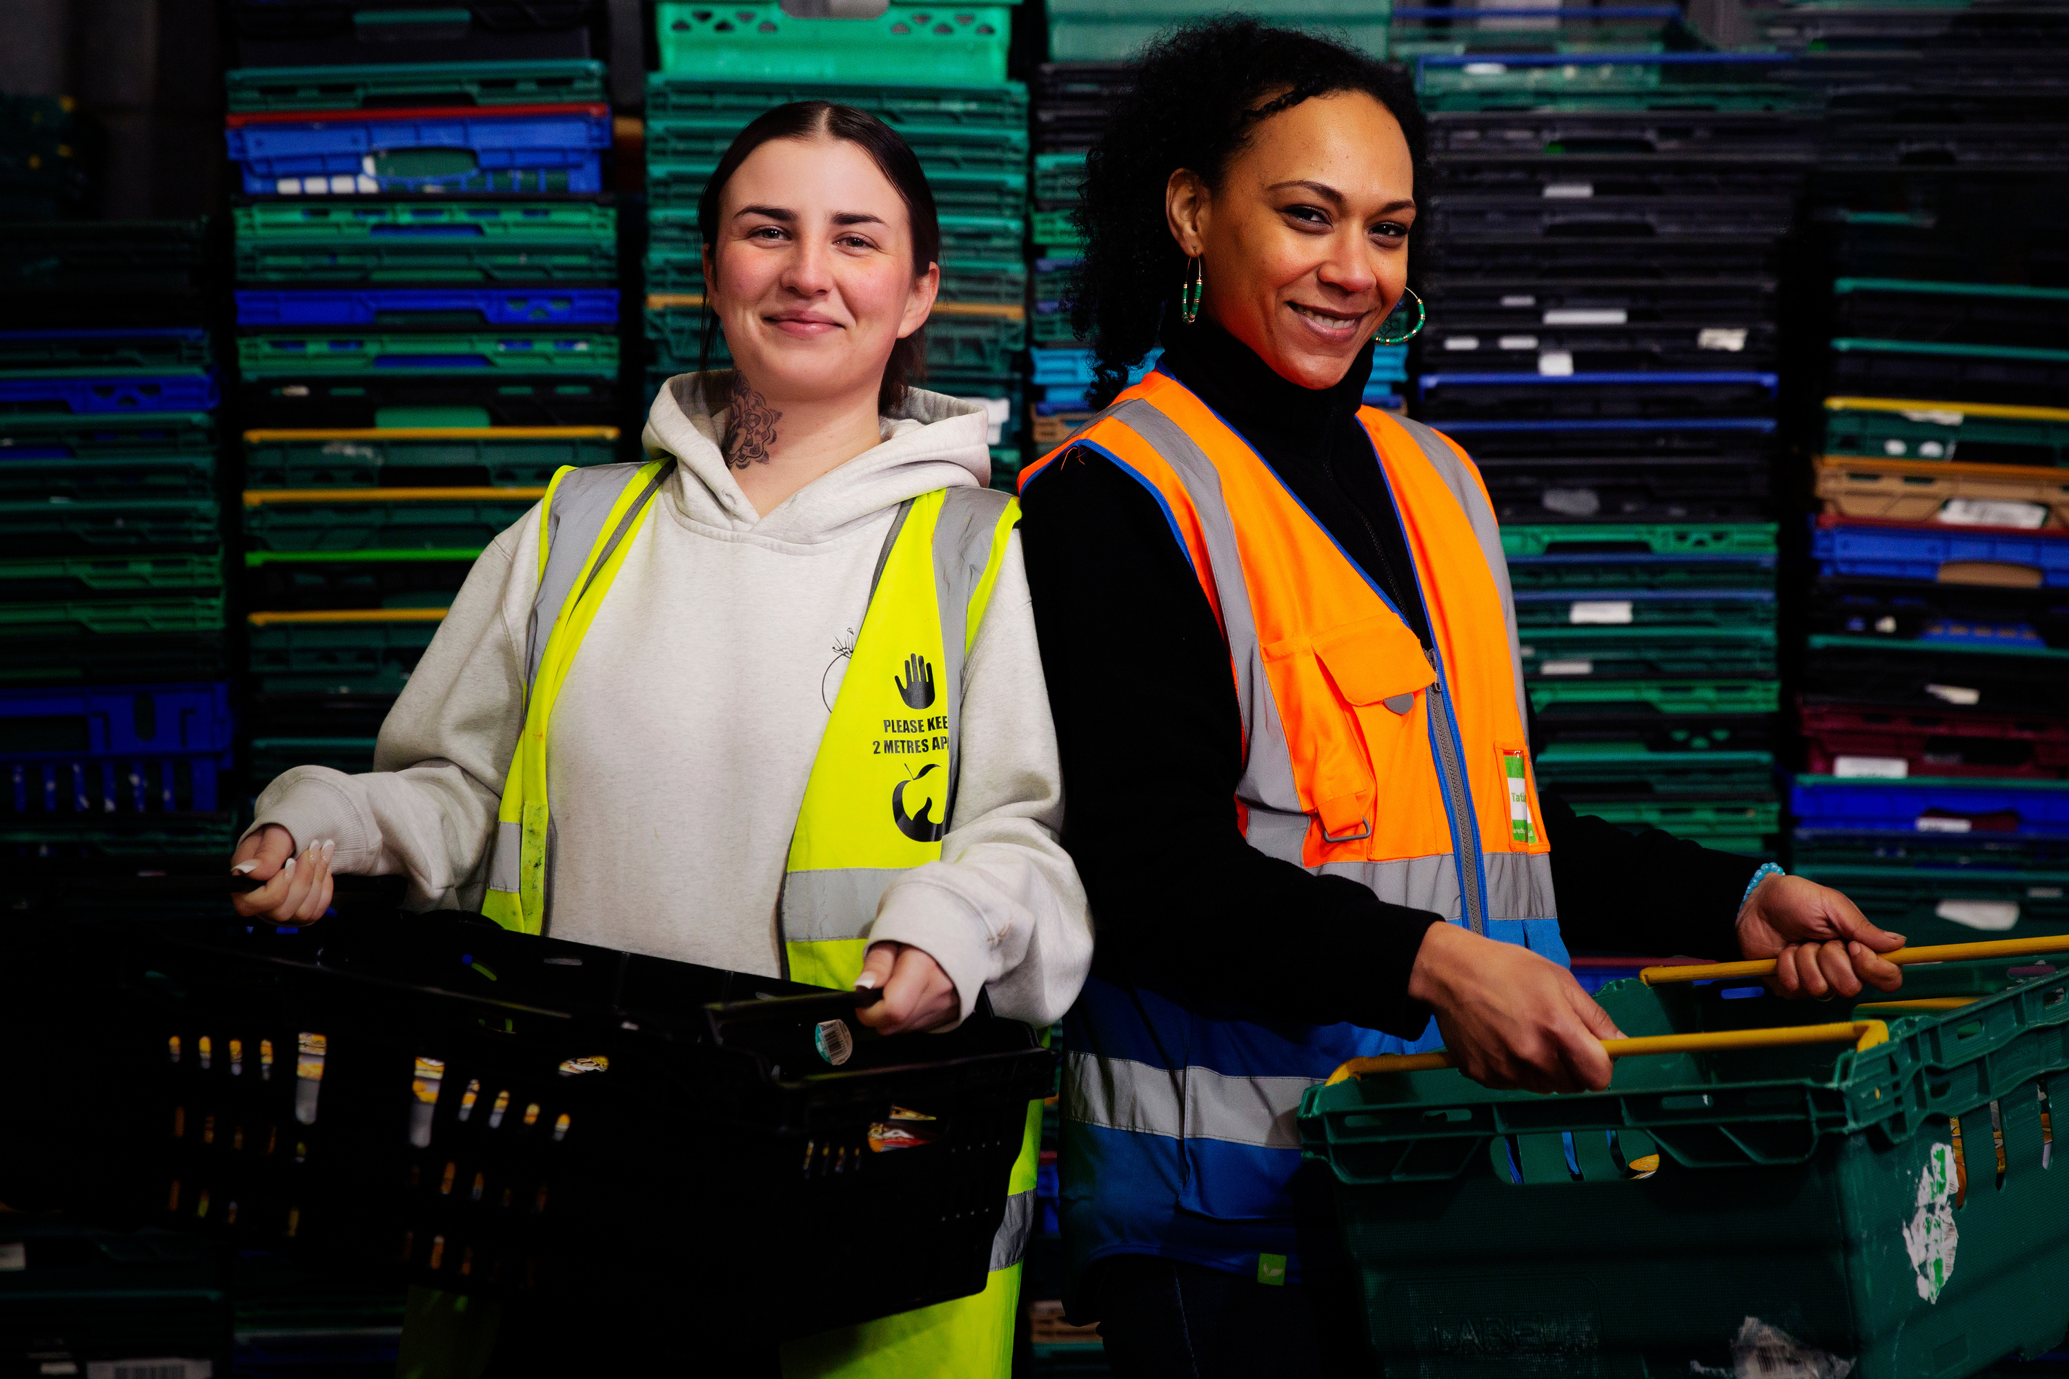

Partner with FareShare South West
Help rescue good food for lasting social impact

Slide 2
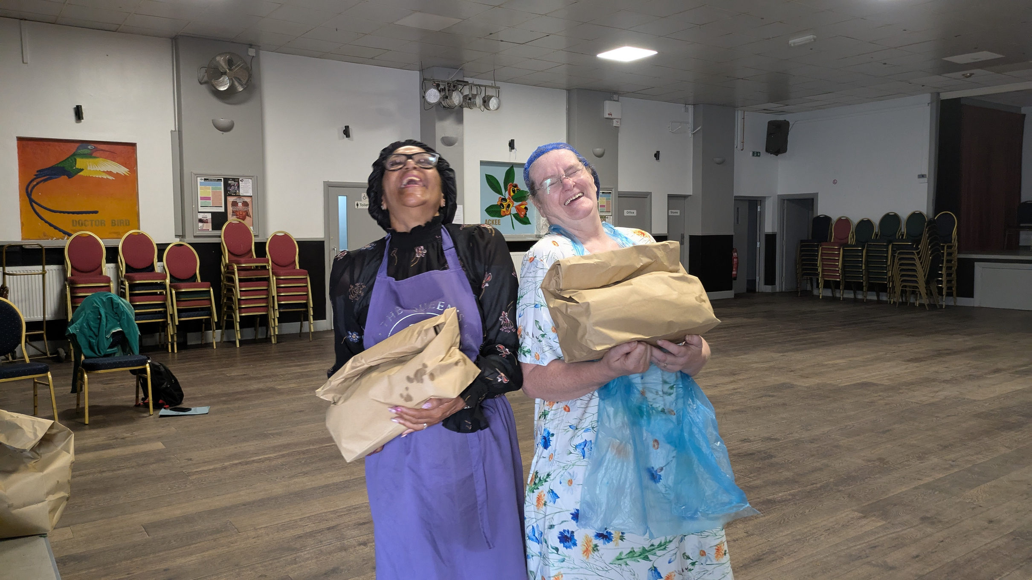
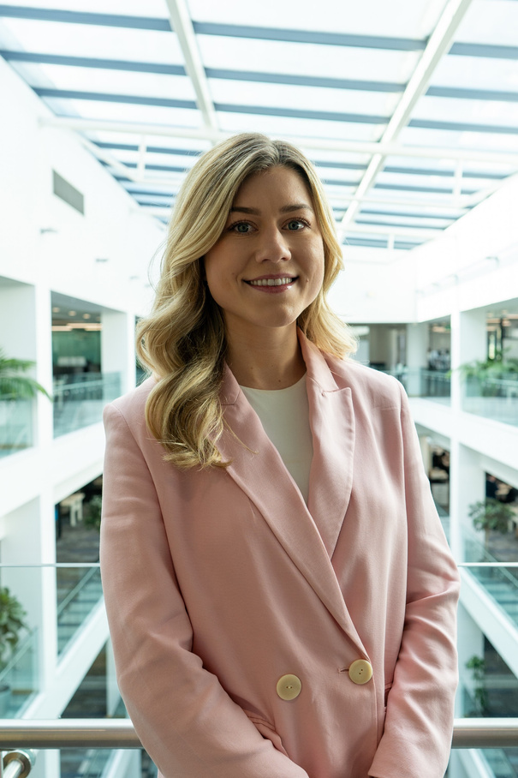
Help sustain a network of hope from Gloucestershire to Cornwall
Tackling the broken food system
Each year, good-to-eat food for 10 billion meals is wasted by the UK food industry with devastating climate impact, while nearly one in five experience food insecurity.
Joining the dots between food waste and hunger
FareShare South West rescues quality food from farms, suppliers, and manufacturers to share millions of meals with over 350 schools, community groups, and food clubs. Over 50% of the food we rescue is fresh fruit, veg, and dairy, helping us fight the injustice of who gets to afford a healthy diet.
Building resilient communities
Food is a catalyst for connecting people with support services that transform lives. We ensure food is available where and when it’s needed – creating dignity, joy, and routes out of embedded poverty for thousands.
You can make a positive impact on your community too when you partner with us. Keep reading to discover how.
“I’m proud that our colleagues chose to stand behind an organisation that tackles hunger with such scale, compassion, and ingenuity. Supporting FareShare South West means supporting stronger, fairer communities and that’s a commitment we’re honoured to make.”
Anna Louden
Hargreaves Lansdown
faresharesouthwest.org.uk | partnerships@faresharesouthwest.org.uk

Slide 3
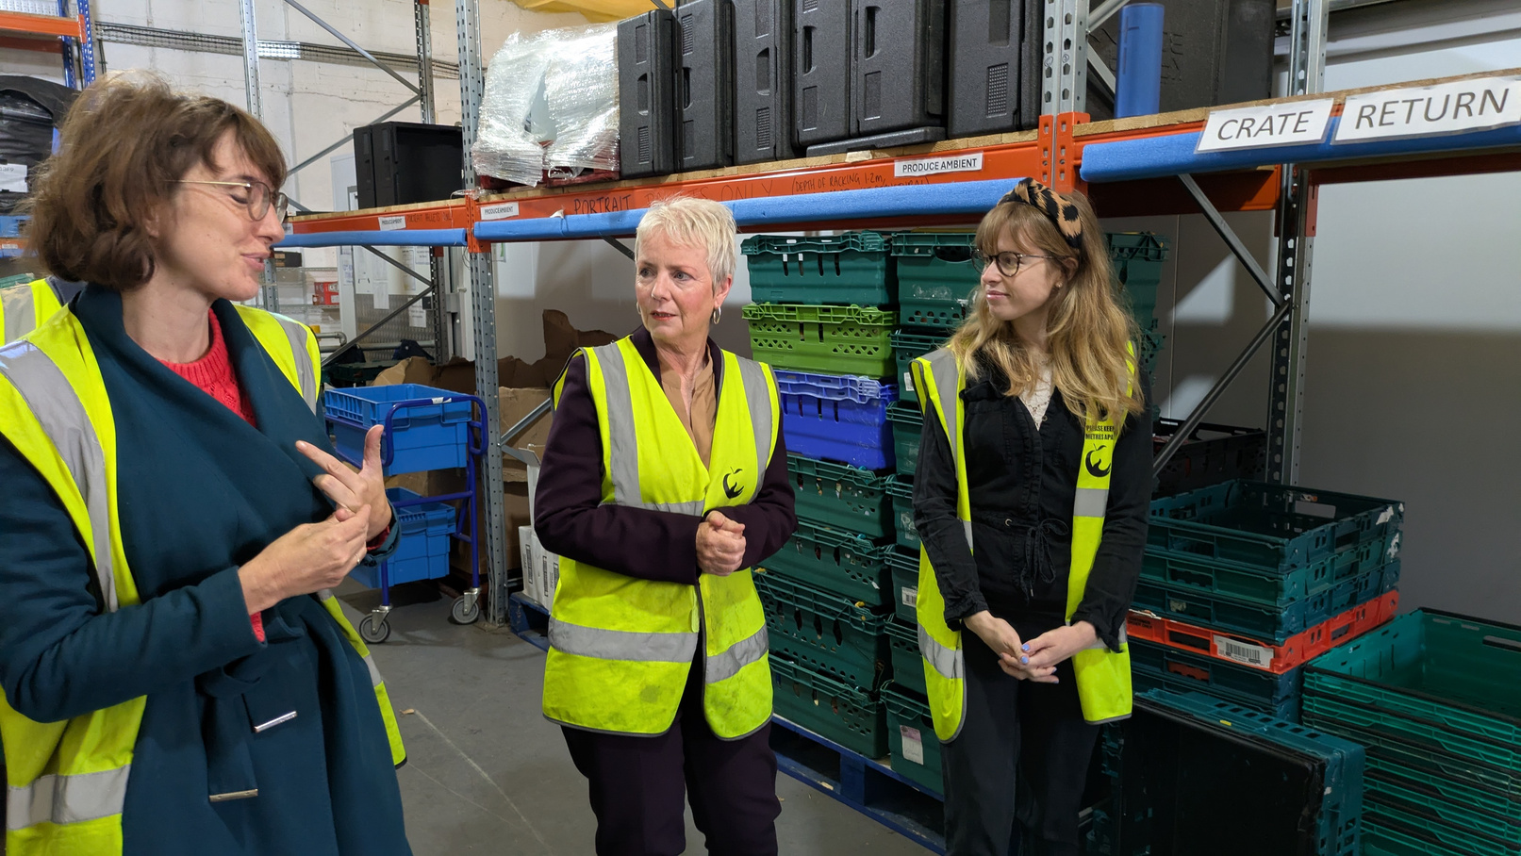
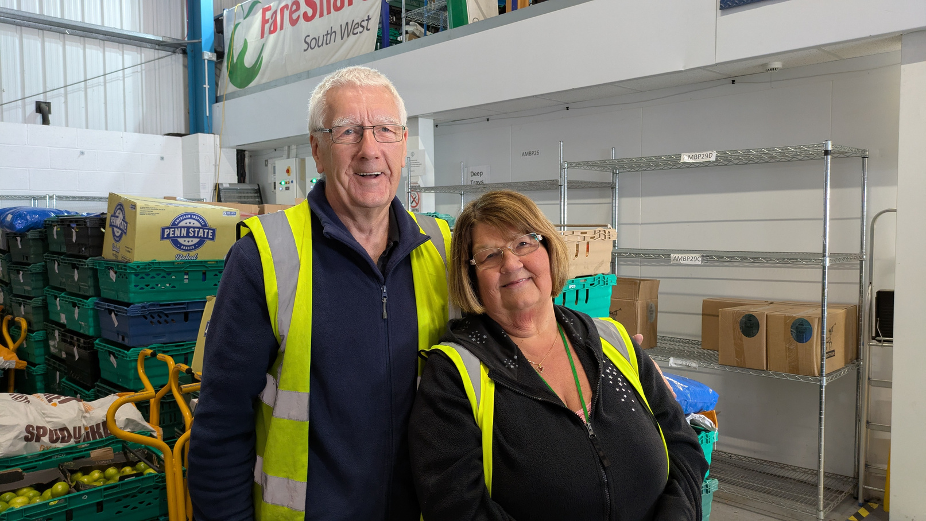
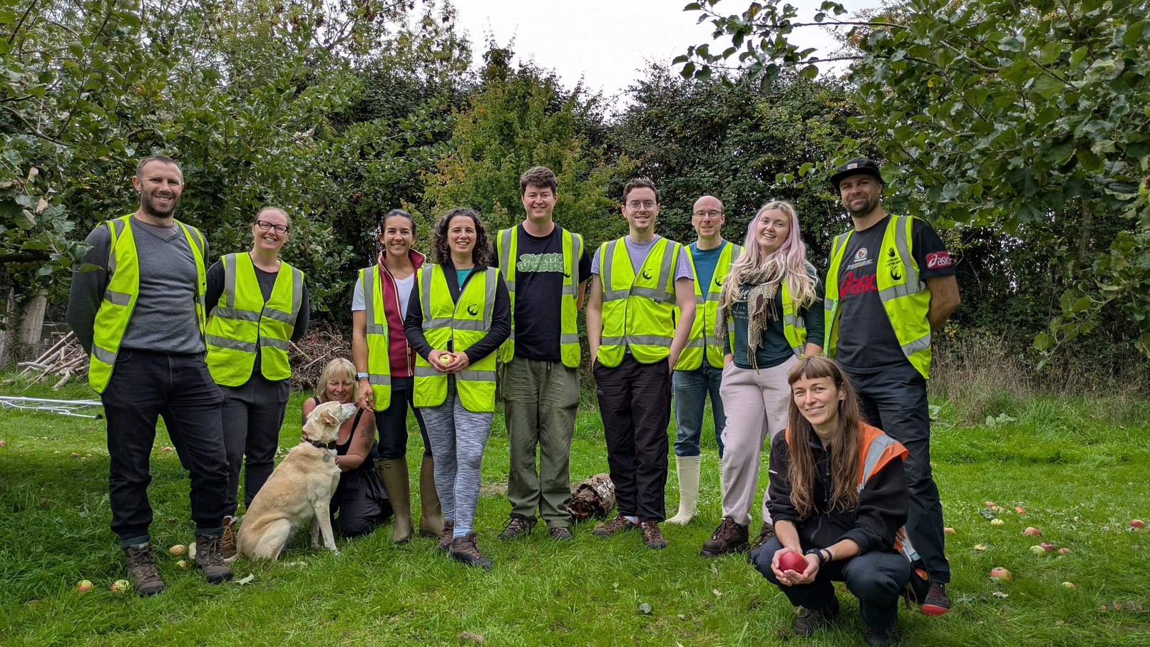
Collaboration is in our DNA
If you and your business are invested in social justice and environmental action, our values align. Here’s what to expect from a partnership with FareShare South West.
  It’s easy! We love creativity and collaboration. Simply tell us what you’d like to achieve, and let’s design a bespoke partnership to get you there.
  Meet your CSR objectives. With every £1 donated providing food for four meals, it’s easy to demonstrate tangible social value to your customers.
  Spark meaningful team engagement. Hands-on volunteering experiences and creative fundraising events offer opportunities for team building, community participation, and boosting staff wellbeing.
  Generate positive PR. Receive regular impact updates and frontline stories that demonstrate the real difference your support makes, providing valuable opportunities to highlight your company’s positive contributions.
  Boost your profile. Create engaging content to inspire your team and we’ll showcase the difference you’re making by sharing your impact across our channels.
  Feel supported. With tailored stewardship every step of the way, you’ll enjoy a seamless partnership experience.
  Be part of better! Help develop resilient communities where all people can thrive.
faresharesouthwest.org.uk | partnerships@faresharesouthwest.org.uk

Slide 4
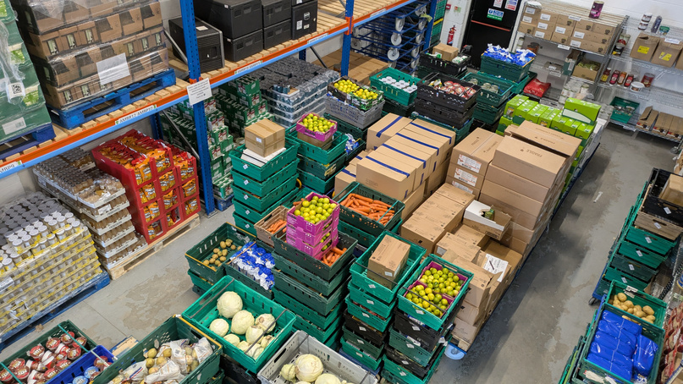
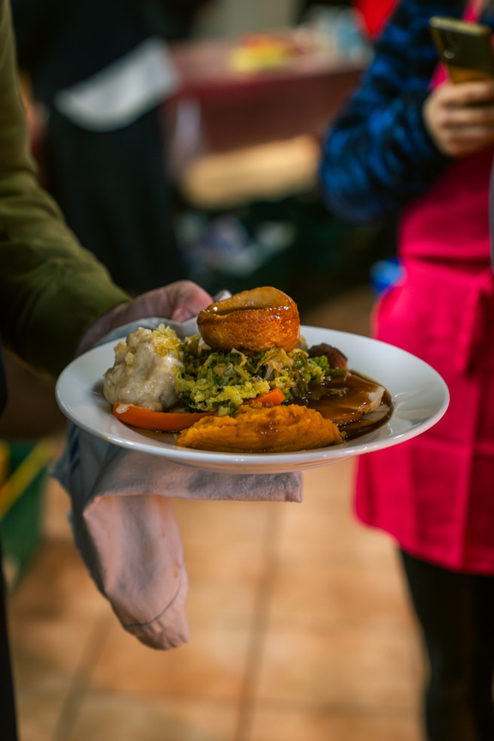
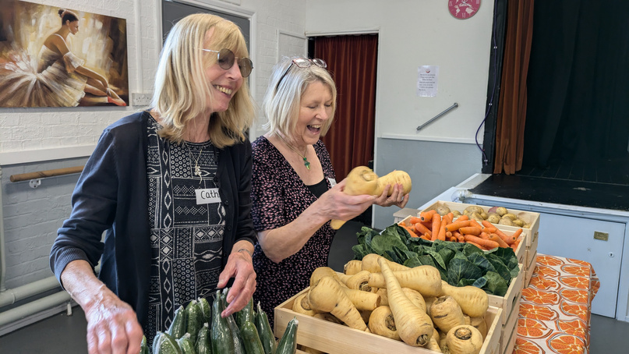
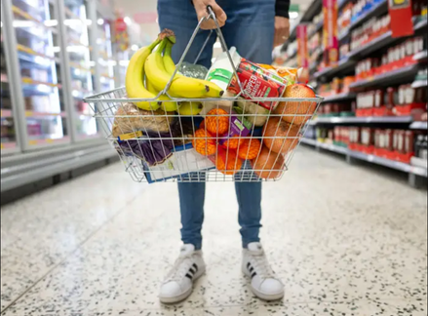
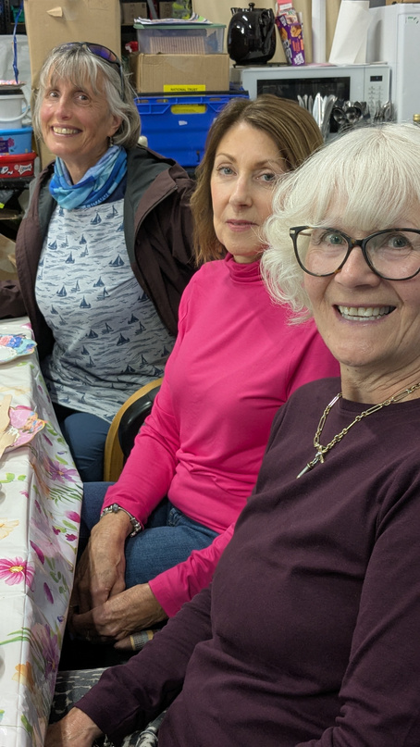

FareShare South West’s impact in 2025/26
In partnership with you, we can do even more.
1.75m kg
4.17m
301
£5.92m
336
32
of food saved direct from the food industry
meals worth of food shared
Community Food Members receving food including schools, pantries & community hubs
worth of food shared
(representing the retail value of food shared)
dedicated volunteers who give their time regularly
people supported with employability opportunities
Our values:
Committed
Inclusive
Resourceful
Collaborative
faresharesouthwest.org.uk | partnerships@faresharesouthwest.org.uk

Slide 5
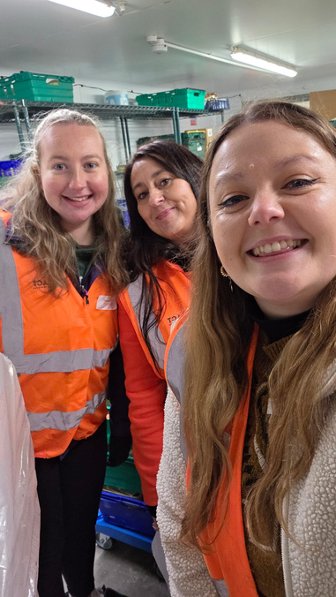
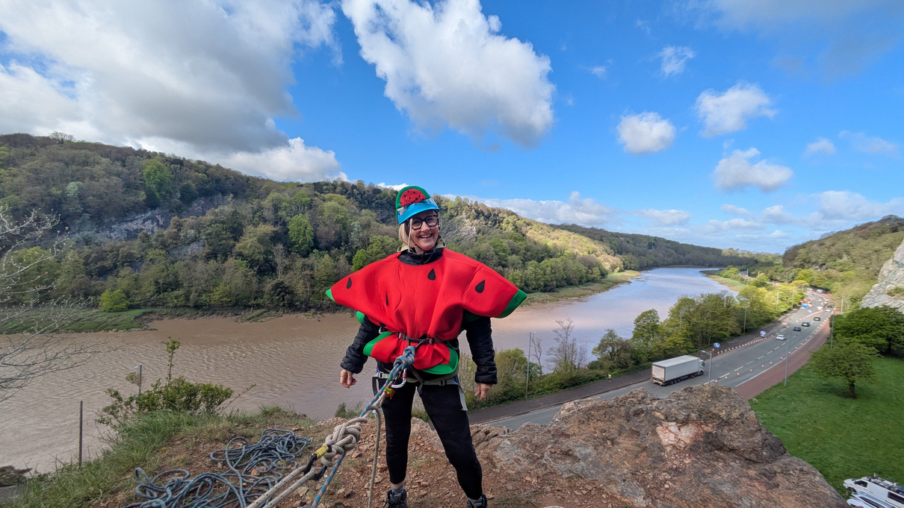
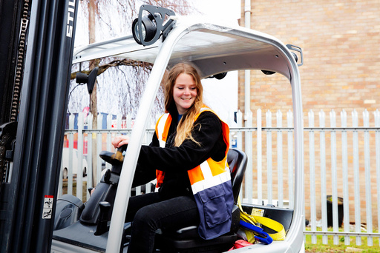
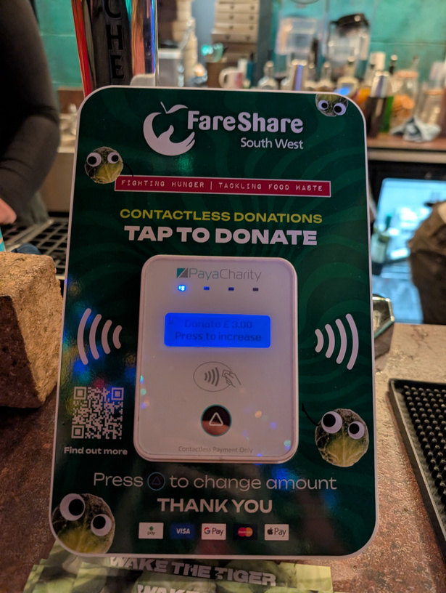

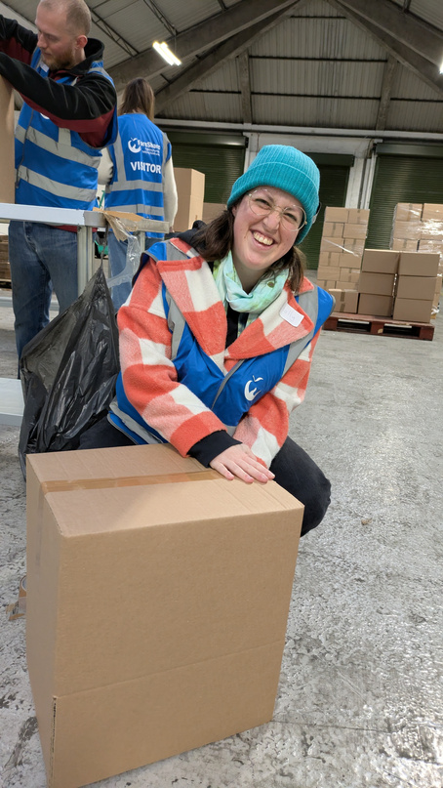
How can you support us?
Nominate us as your charity of the year
Perfect Stays organised various fundraisers, gathered their team for corporate volunteering, and donated for every booking to raise a total of £3,462.
Fundraise for us
Join one of our abseils down the majestic Avon Gorge, sign-up for a third party event, or create your own fundraiser.
Make a charitable donation
Support the regional network that provides food to community projects and enjoy meaningful tax benefits.
Or create your own campaign
Wake the Tiger created an entire SPROUTERverse over the 2025 festive season promoting our work and raising money for over 80,000 meals.
Match funding
Pledge your support for our annual Big Give Campaign or set up your own.
Payroll giving
Fund meals every month by inspiring your staff to become Food Friends.
faresharesouthwest.org.uk | partnerships@faresharesouthwest.org.uk

Slide 6

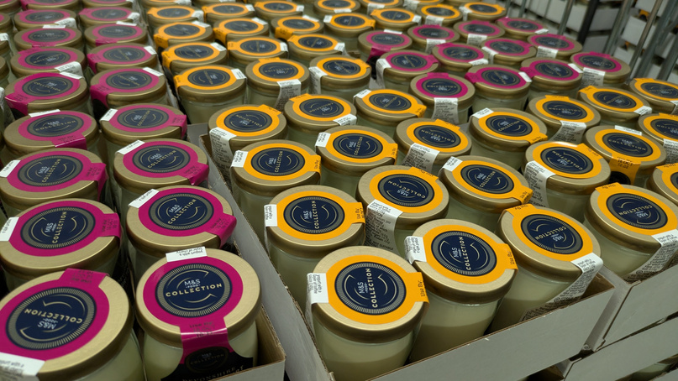
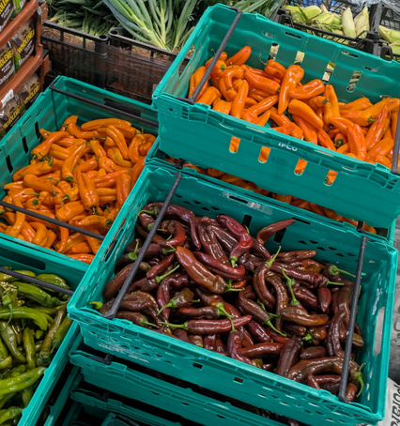
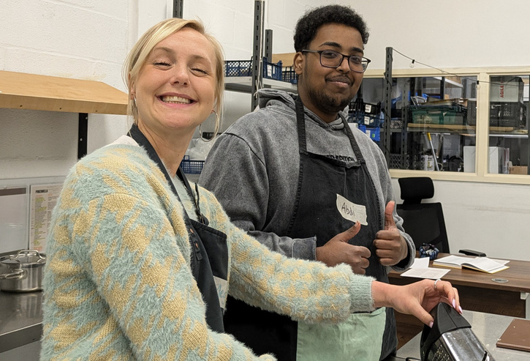
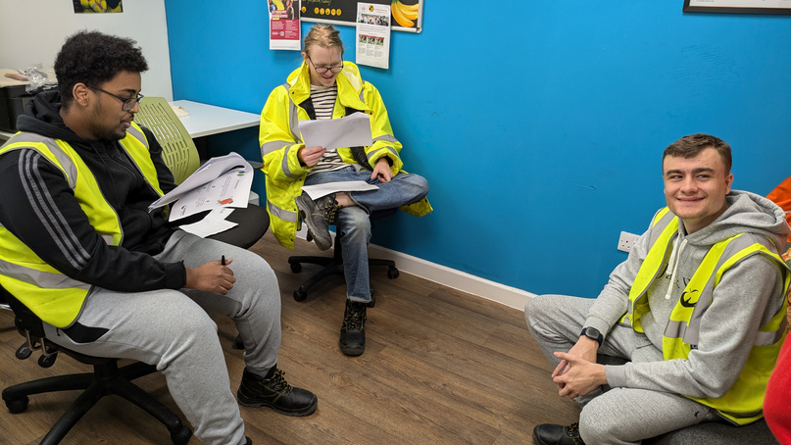
How will your donation be used?
Every £1 you donate can rescue food for four meals. That could mean:
£274
£496
£909
£2,500
£7,444
£10,000
keeps a child fed, every meal, every day of the year
provides a months’ worth of food to four school breakfast clubs
saves one tonne of surplus food from going to landfill
shares 10,000 hot meals and brings people together through food at winter
covers the full costs of a young person on a supported, paid internship
shares enough food for a member to produce 40,000 meals
faresharesouthwest.org.uk | partnerships@faresharesouthwest.org.uk

Slide 7
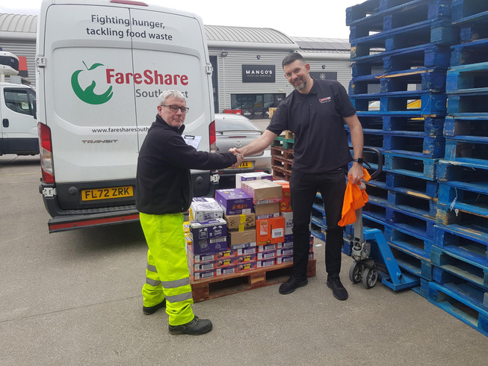
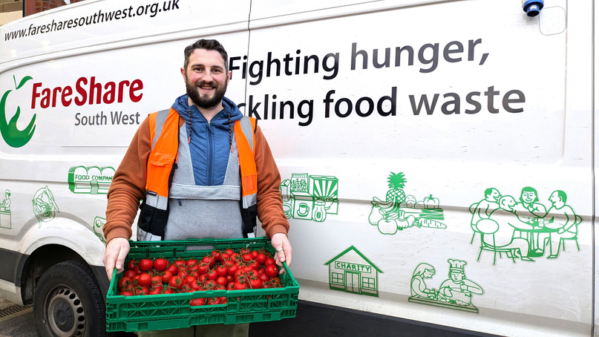
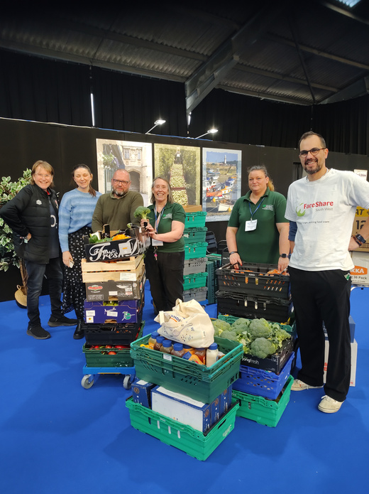
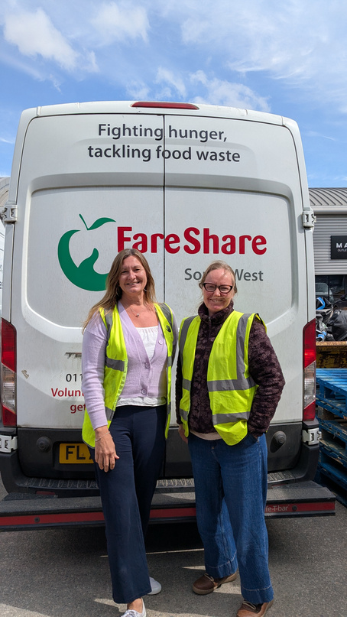
Offer support in a way that suits you best
Donate food
Join companies such as Luscombe Drinks and Hobbs House Bakery in donating food items to share with our member charities.
Donate equipment
Our operation has many moving parts. Let us know if you’d like to donate a van, contribute to community kitchens, or help upgrade our offices.
Organise an ambient food collection
Host a collection point for staff and customer donations. We can provide crates, posters to print, and an essentials food list.
Tell us what you care about
We know what we’re trying to achieve: a future where no food is wasted and all people can thrive.
What matters most to you?
The best partnerships come out of aligned values, open communication, and clarity of purpose. We’ll bring our experience, ideas, and opportunities, but we’re also here to listen and learn.
Volunteer your skills
From marketing to accountancy to logistics, plug your skills and experience into our operation and help us do more.
faresharesouthwest.org.uk | partnerships@faresharesouthwest.org.uk

Slide 8

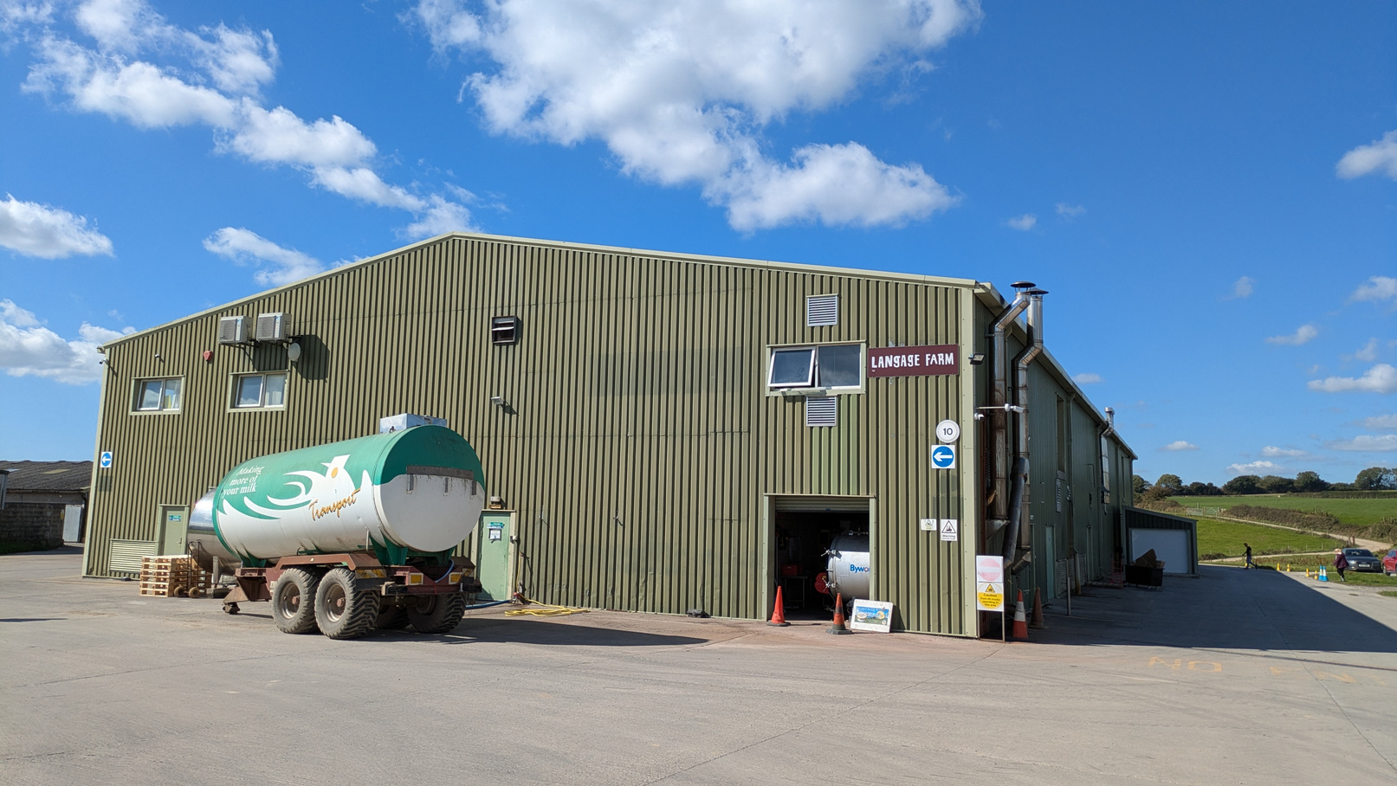
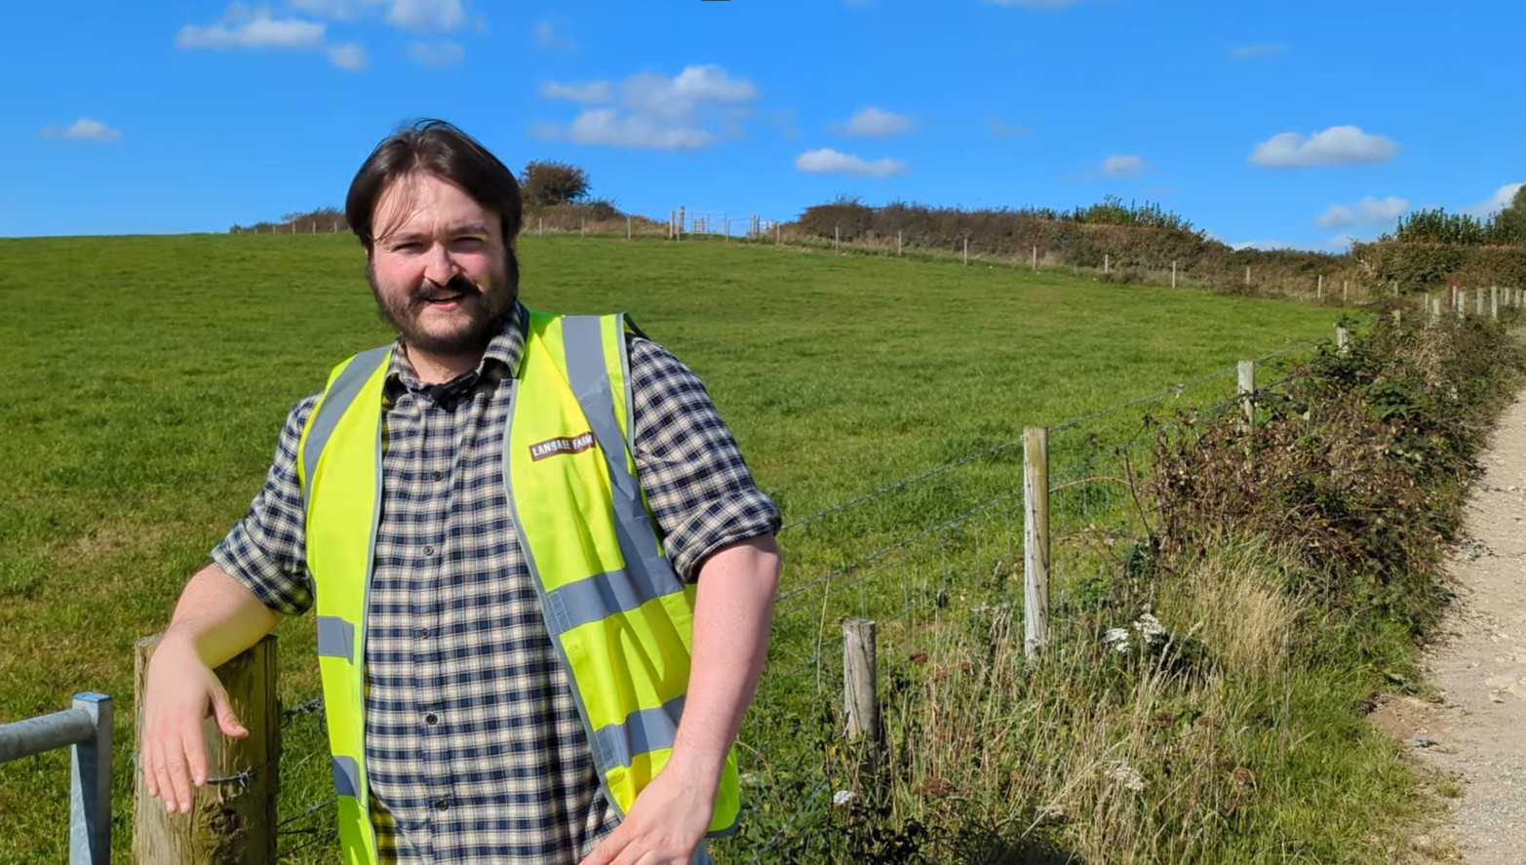
Or create a partnership that’s totally unique
Langage Farm is renowned for clotted cream, ice-cream, and luxury yoghurts. It’s also the UK’s first carbon-neutral dairy, home to a pioneering anaerobic digestor which converts food waste into green energy. When products don’t meet their exact standards – too much fruit in a jar or too little – it comes to us.
“Working alongside FareShare South West is mutually beneficial. We can supply surplus food that they distribute, but also take their food that isn’t of a quality they can share. We put that surplus into our anaerobic digestion facility where it gets produced into green energy. So it makes a nice little green loop.”
Ben Harvey, Langage Farm
faresharesouthwest.org.uk | partnerships@faresharesouthwest.org.uk

Slide 9
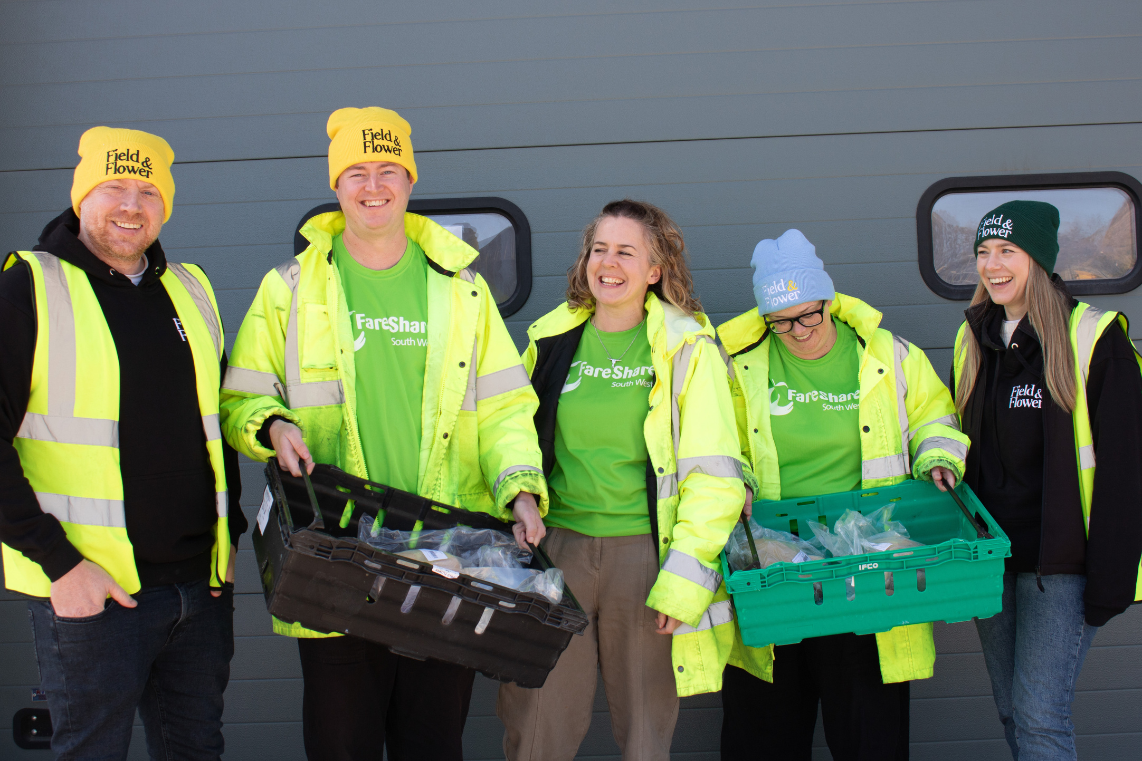
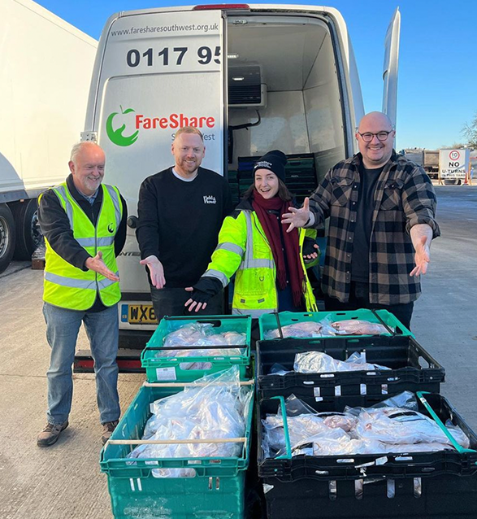
How Field & Flower support us
“We wanted to make sure that those who were in need or didn't have access to high quality meat could get it.”
Field & Flower started by sharing free range meat and sustainable fish from cancelled orders and have gone on to raise funds through customer donations. Their support has enabled us to provide food for 480,000 meals. They also spearheaded the Leg Up campaign, which saves turkey legs from going to waste at Christmas and ensures they reach people who might otherwise go without.
“We want to build long term relationships that are sustainable, where we can make a difference over a long period of time. We’re ten years in and that's a relationship that we're really proud of. For me, it’s probably one of our best achievements since setting up the business.”
Co-founder James, Field & Flower
faresharesouthwest.org.uk | partnerships@faresharesouthwest.org.uk
faresharesouthwest.org.uk | partnerships@faresharesouthwest.org.uk

Slide 10
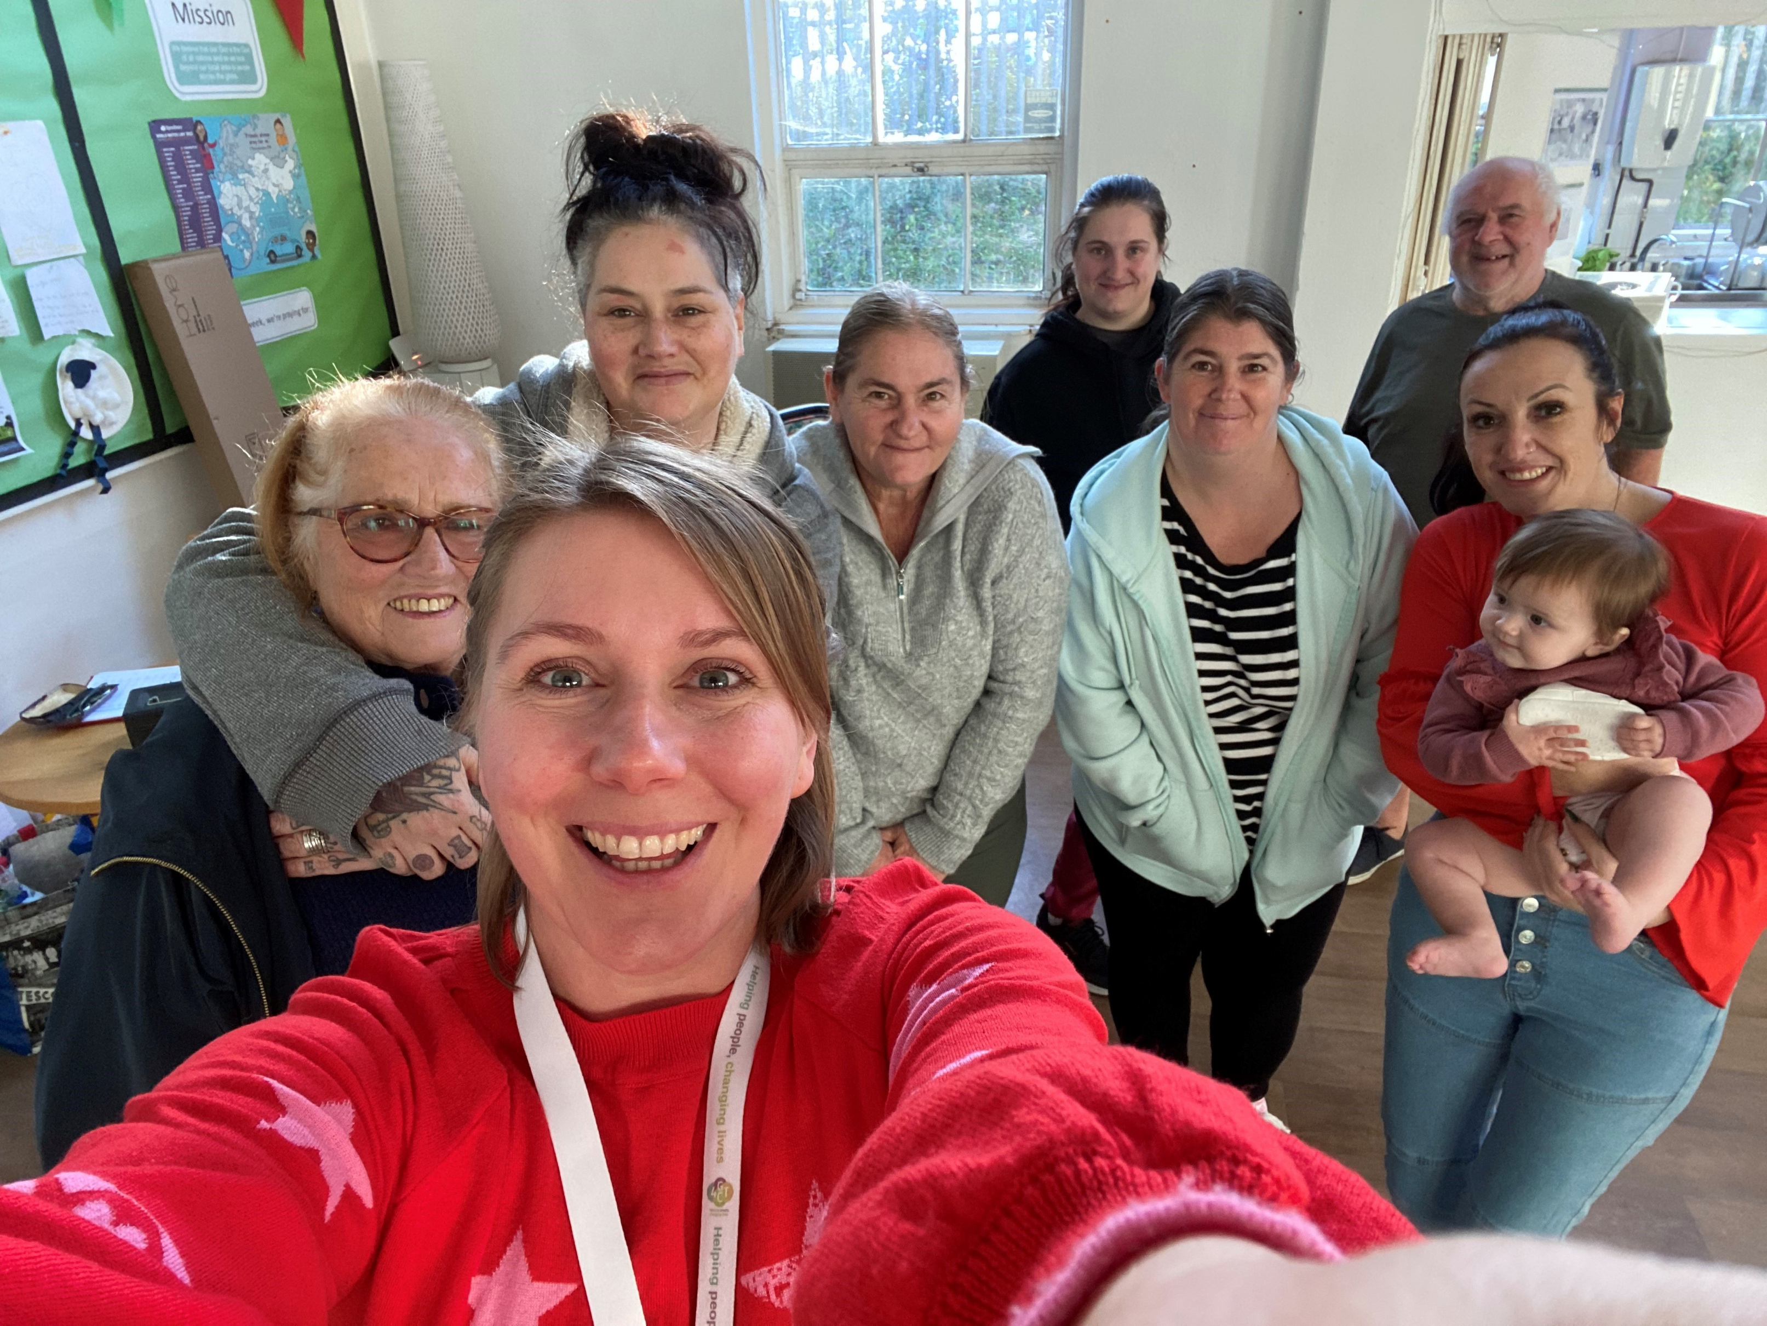
Your partnership supports projects like this
Plymouth Food Co-Ops
Food co-ops are neighbourhood buying groups owned and run by the people who use them. Co-op members effectively set up their own local food hub in which they volunteer their time, and contribute the same amount of money to organise their weekly shop.
FareShare South West supports co-ops with weekly deliveries of affordable, good-to-eat surplus food. Co-ordinator Kelly said: “We would not be able to do this without FareShare South West, it enables members and their families to access lots of healthy nutritious fruit and vegetables at a very low cost.”
“The food co-op helped me through a dark time and provided me with the ability to broaden my recipe ideas. The social aspect and friendships made have massively benefitted my mental wellbeing.”
Plymouth food co-op member
faresharesouthwest.org.uk | partnerships@faresharesouthwest.org.uk

Slide 11
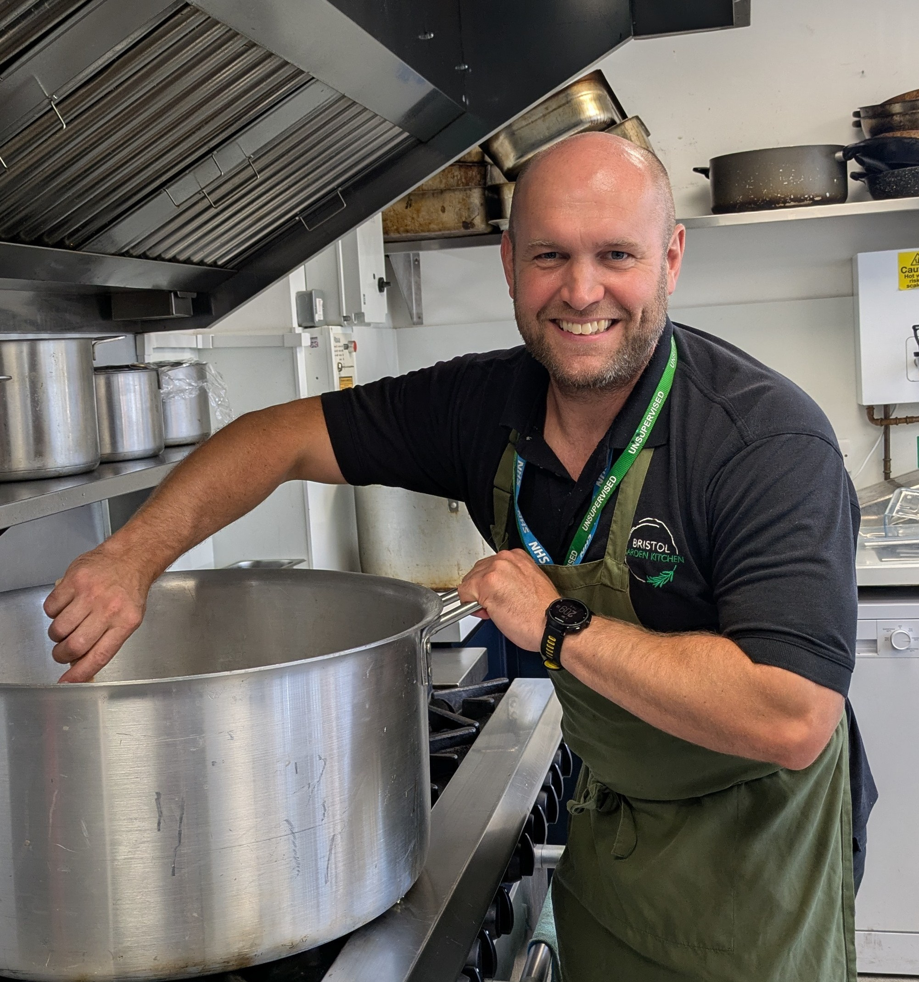
Your partnership supports projects like this
Learning Partnership West, Bristol
LPW provides alternative learning provision in Bedminster, and also coordinates mentoring, play and youth sessions, including Hartcliffe’s Big Hideout adventure playground. 1 in 6 people in Hartcliffe leave school with no qualifications, so support to stay engaged with education is vital.
FareShare South West’s weekly deliveries of fresh ingredients mean better nutrition for young people as they grow. The food gives gives children a high-quality meal and the opportunity to try new dishes and ingredients, broadening their experiences at the same time as reducing food waste.
“When it comes to health, what you’re putting inside your body is huge. Through cooking sessions, students learn valuable life skills. We give them the confidence to go and cook some relatively simply things at home.”
Ash, chef
faresharesouthwest.org.uk | partnerships@faresharesouthwest.org.uk

Slide 12
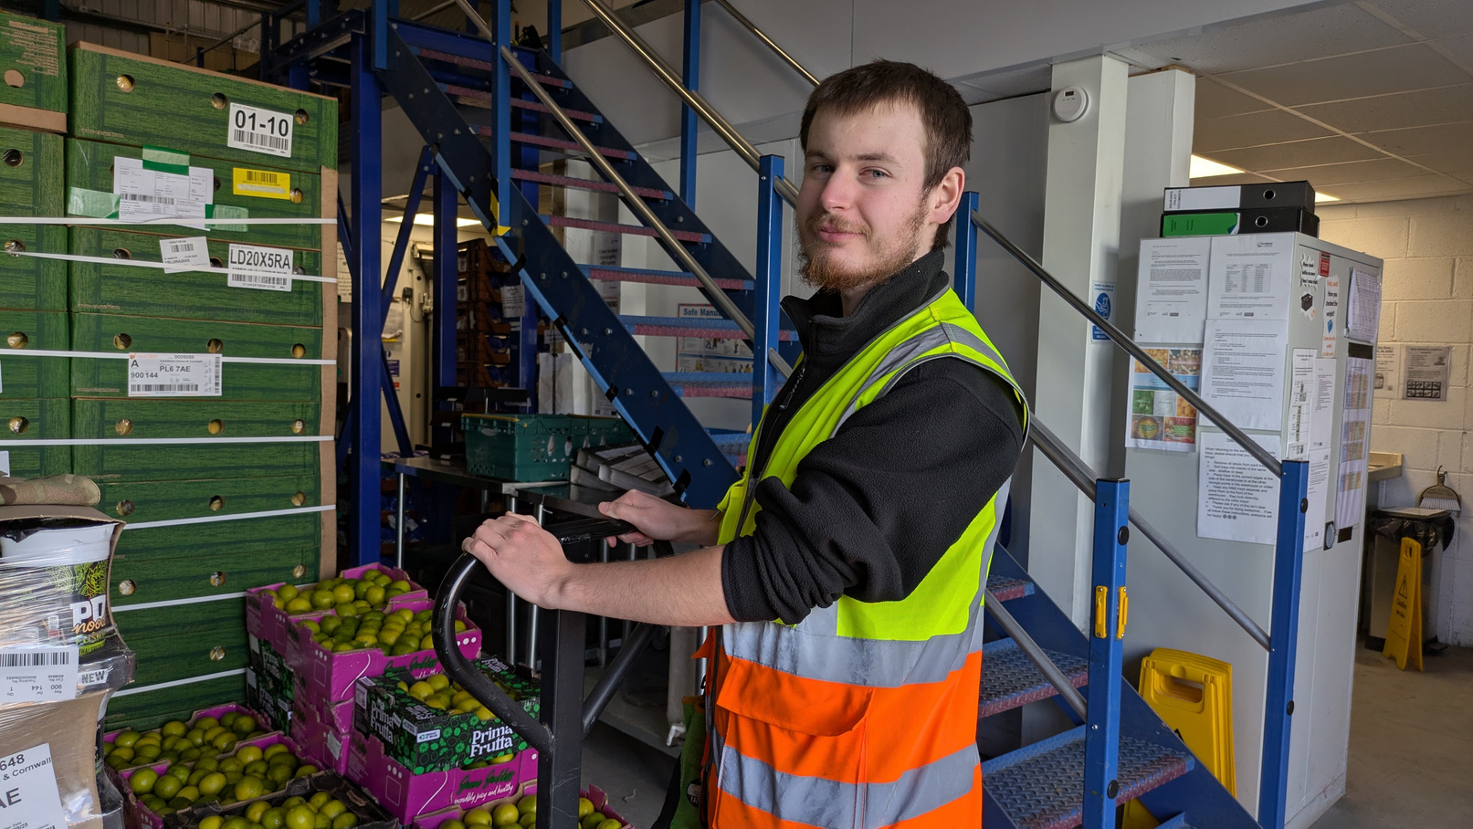
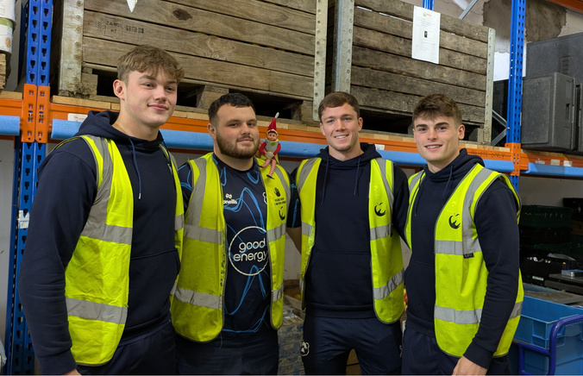
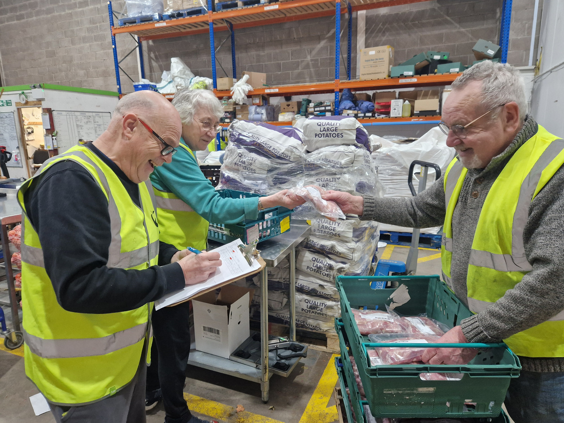
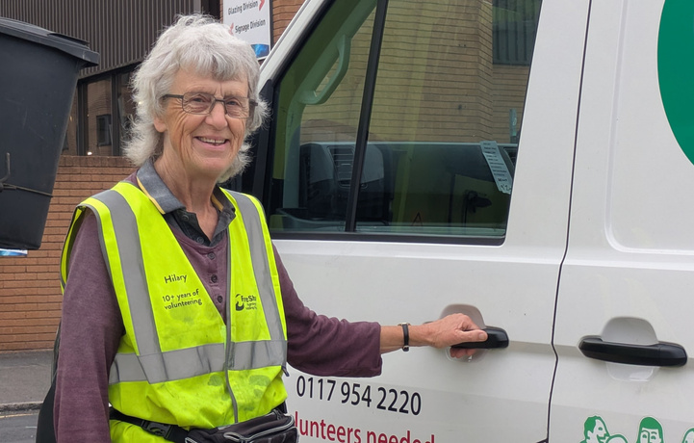
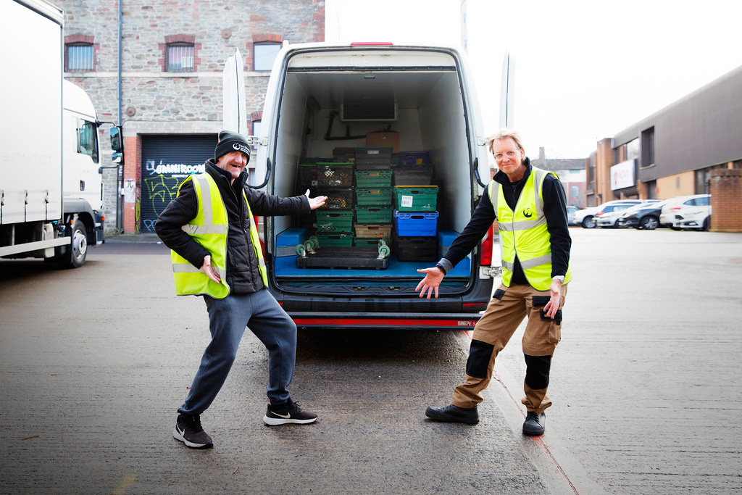
Corporate volunteering opportunities
Our partners tell us they love volunteering! Join us for an active, inspiring day, supporting us with tasks that benefit people and planet, and bring FareShare South West to life.
At a hub: for teams of 4 to 6 volunteers
As a group of Warehouse Assistants, make real impact by supporting our daily operations with hands-on, active tasks. From packing food orders to quality-checking our fresh produce, these shifts are great for teambuilding and colleague wellbeing.
“It's ben ver
On a van as a Driver’s Mate: for individuals
Load up a van and jump in with a volunteer driver, helping to deliver good food directly to the doorsteps of those we support. You’ll meet brilliant charities and people on the frontline as you navigate Bristol and beyond to make food deliveries.
“A rewarding day that takes you away from the day to day role and makes you appreciate the volume of food that would go to waste.”
Olly, corporate volunteer
faresharesouthwest.org.uk | partnerships@faresharesouthwest.org.uk

Slide 13
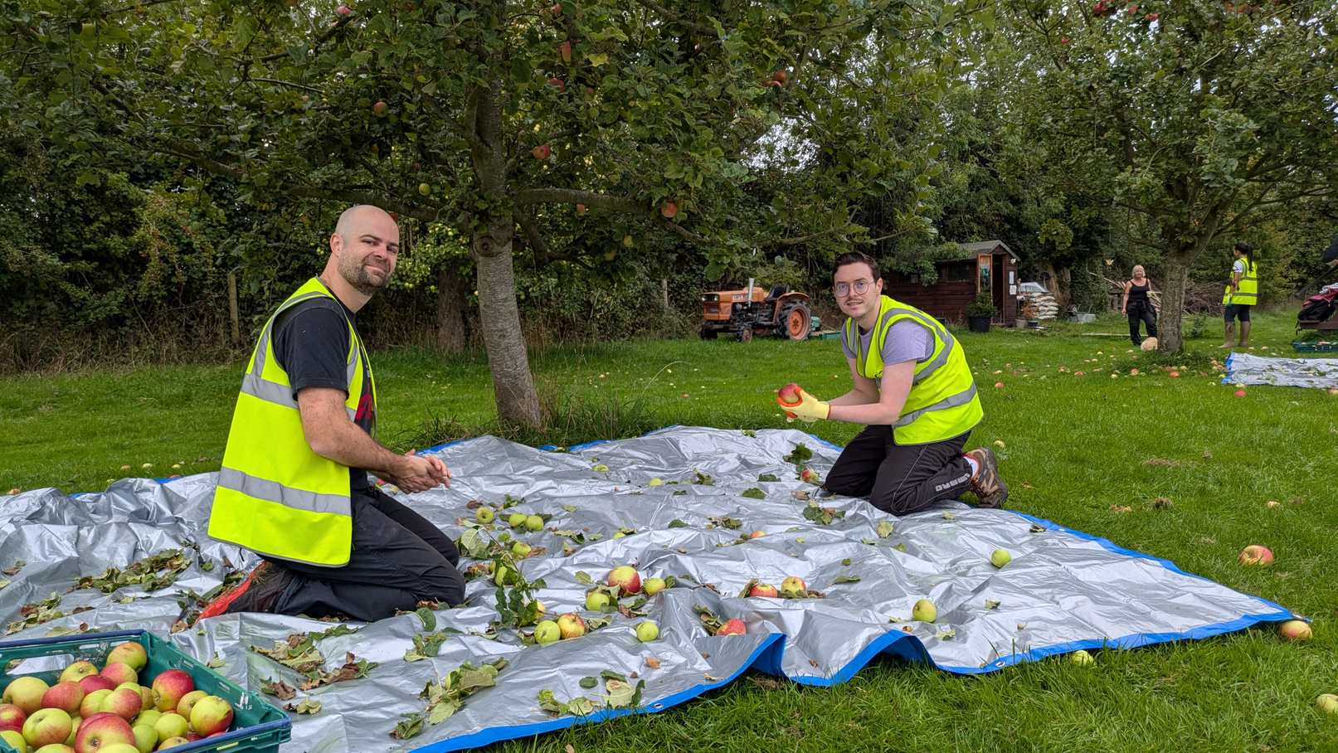
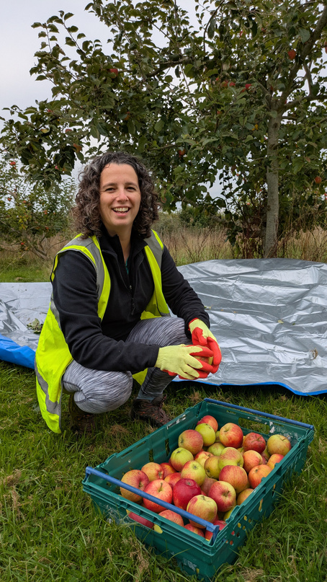
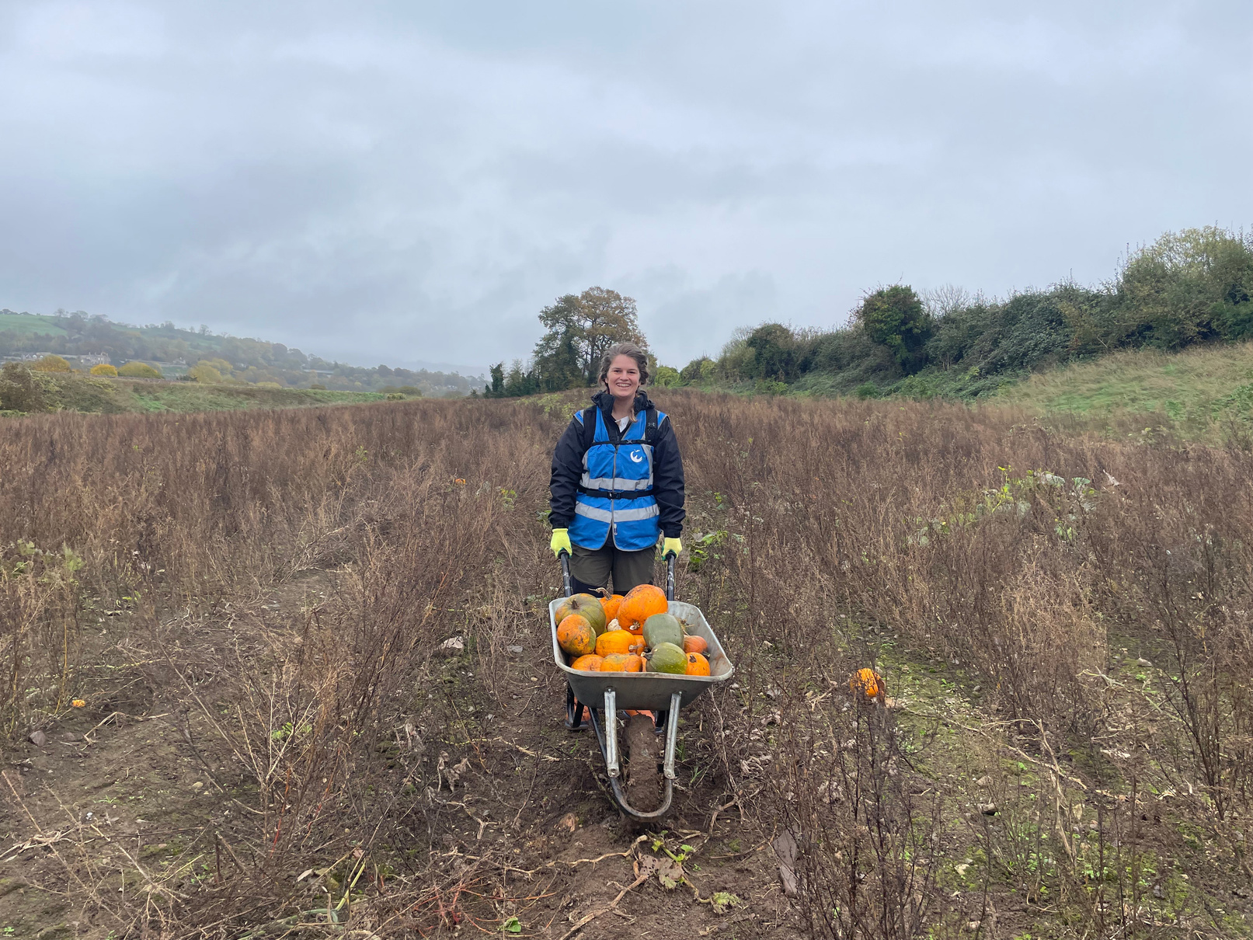
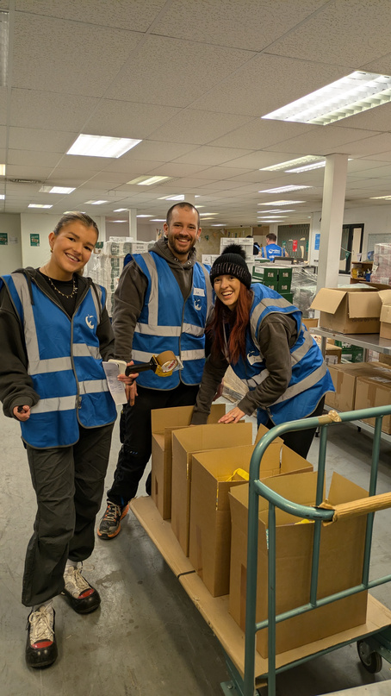
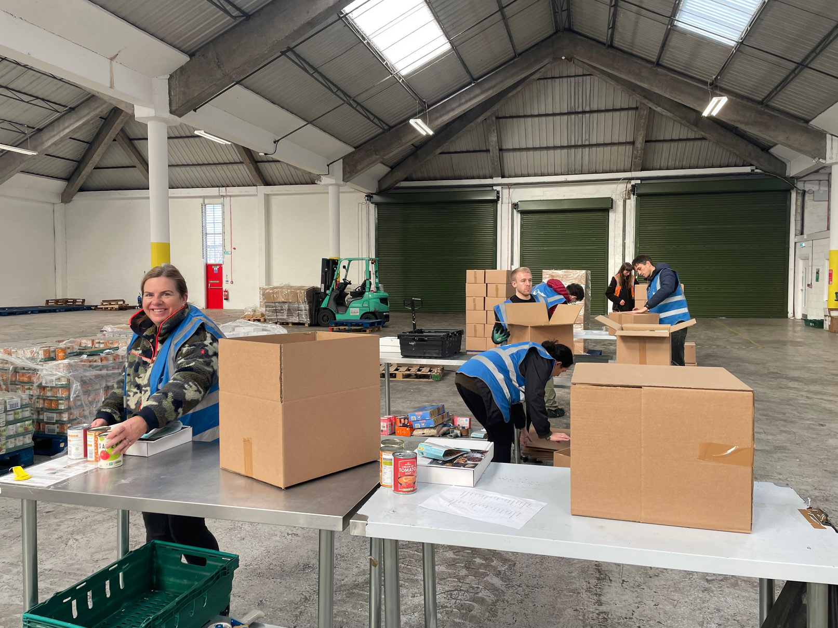
“It's been very
Special corporate volunteering opportunities
Seasonal farm volunteering
Spend a day in a farm or orchard with your team harvesting surplus food directly from the field. A fantastic day out in nature that is great for wellbeing, team bonding, and making a real impact.
Winter parcel packing
Join us with your team to spread festive cheer while packing holiday food and activity parcels for families in receipt of free school meals outside term time across Bristol, Bath, and Northeast Somerset.
Did you know? We prioritise group volunteering opportunities for partners.
If there’s space, other groups can book a shift. For this, we suggest a £50 per person donation. This helps you support us financially without committing to a full partnership and reflects the work our teams invest in creating your experience.
faresharesouthwest.org.uk | partnerships@faresharesouthwest.org.uk

Slide 14
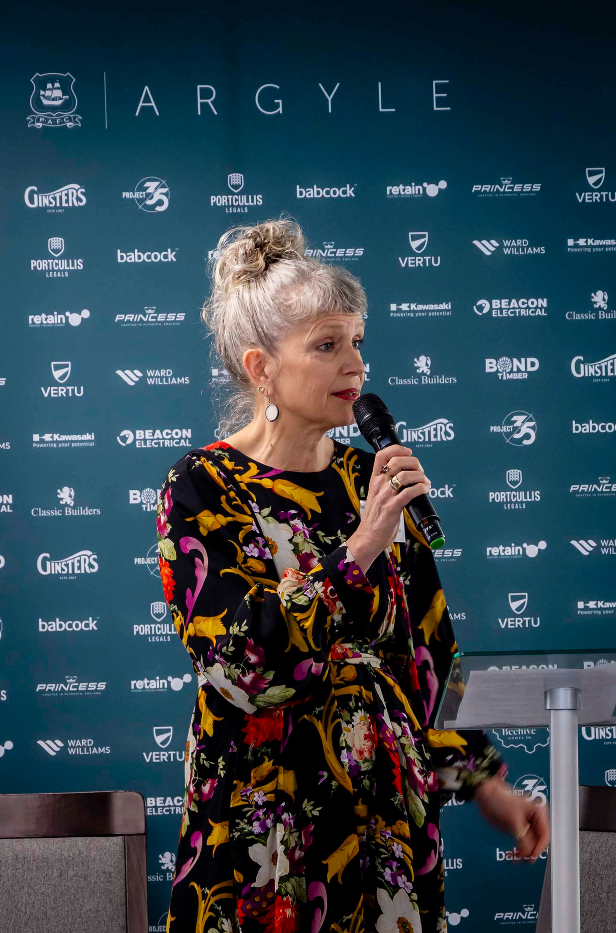
Now’s the time to act
“Food insecurity has been and remains a stark reality for many vulnerable individuals in the local region. The issues, as we know are highly complex. We need to continue to work together to co-create a collective solution to this ongoing critical issue. And this requires us to do things differently. It might push us out of our comfort zone. We might need to work with new people, new partners who have different agendas and cultures. But we need to consider and embrace innovation and creative approaches to catalyse the change required.”
Dr Clare Pettinger - award-winning Registered Dietitian, Public Health Nutritionist and experienced educator speaking at FareShare South West’s Spring Summit held at Home Park in 2025
faresharesouthwest.org.uk | partnerships@faresharesouthwest.org.uk

Slide 15
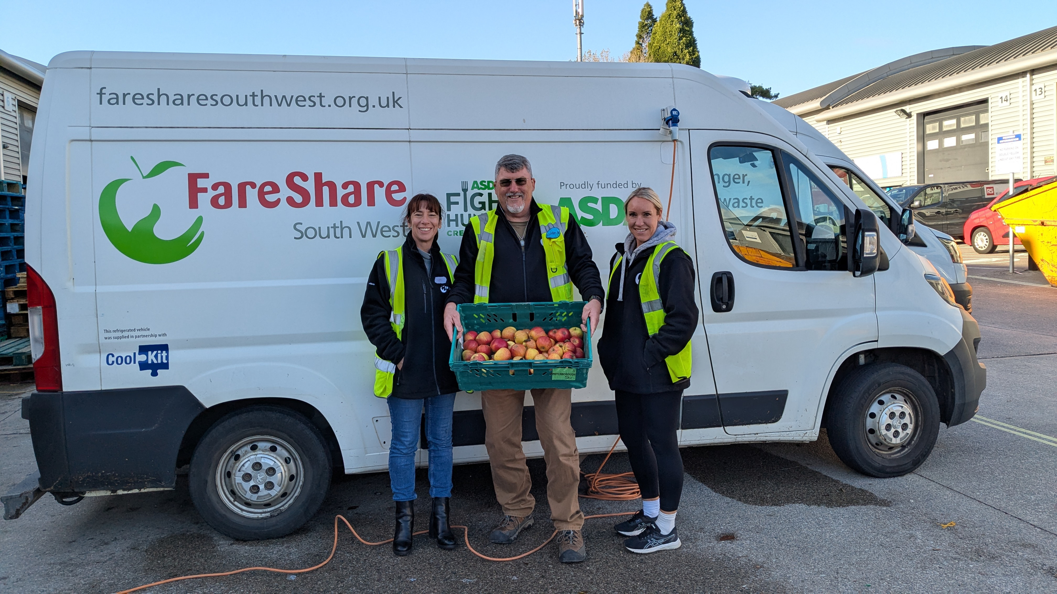
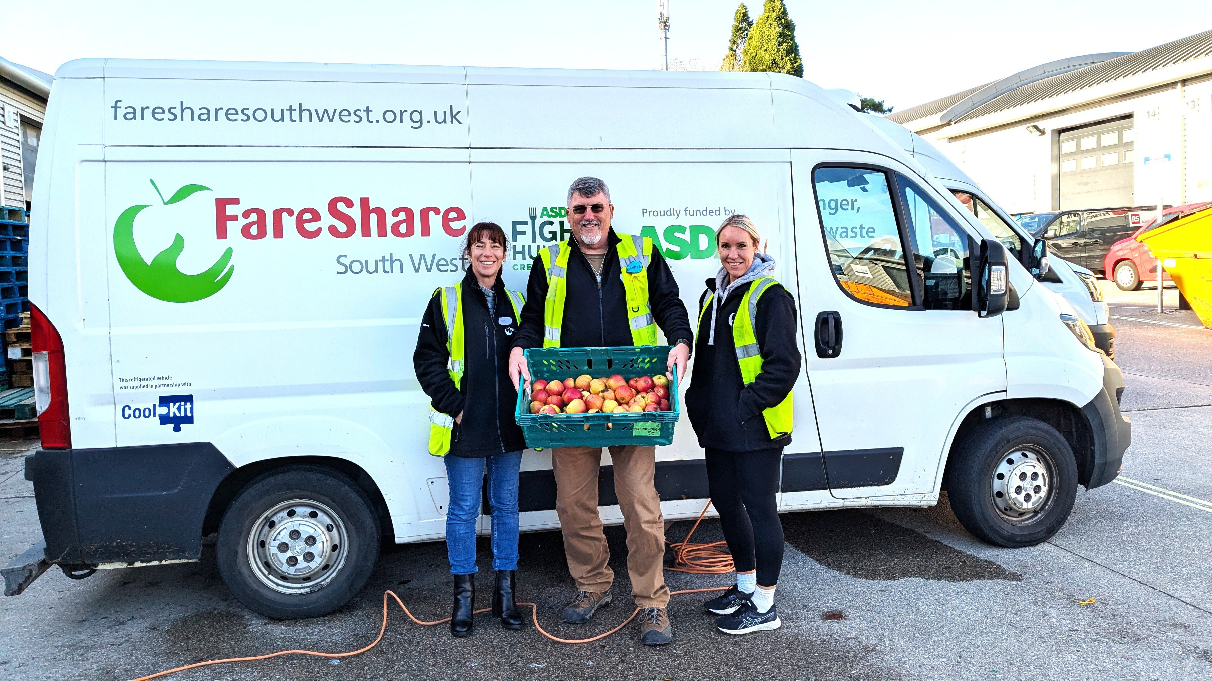
Start your partnership journey today
Are we a good fit for you?
The strongest partnerships are created when charities listen. Tell us what you want to achieve.
Talk to the team today at partnerships@faresharesouthwest.org.uk
faresharesouthwest.org.uk | partnerships@faresharesouthwest.org.uk

